Slide 1
HEART DISEASE PREDICTION
MUBEENA. C
ROLL_NO :MES20MCA-2031
PRODUCT OWNER : JABIR SIR

Slide 2
TABLE OF CONTENTS
Introduction
Modules
Methodology
Data Flow Diagram
Table Design
Developing Environment
Future Enhancements
User Stories
Product Backlog
Project Plan
Sprint Plans
Sprint Backlog
Sprint Backlog Actual

Slide 3
INTRODUCTION
With the rampant increase in the heart stroke rates at juvenile ages, we need to put a system in place to be able to detect the symptoms of a heart stroke at an early stage and thus prevent it. It is impractical for a common man to frequently undergo costly tests like the ECG and thus there needs to be a system in place which is handy and at the same time reliable, in predicting the chances of a heart disease. Thus we propose to develop an application which can predict the vulnerability of a heart disease given basic symptoms like age, sex, pulse rate etc. The machine learning algorithm neural networks has proven to be the most accurate and reliable algorithm and hence used in the proposed system
We thus propose to collect relevant data pertaining all elements related to our field of study, train the data as per the proposed algorithm of machine learning and predict how strong is there a possibility for a patient to contract a heart disease. For the purpose of patients entering data, we suggest to make use of the easily available sensors in watches and cell phones to measure the simple factors.

Slide 4
MODULES
MODULE 1 :-ADMIN
login
change password
view dataset
view users
view complaint
send reply

Slide 5
MODULE 2:- USER
sign up
login
view profile
change password
prediction using random forest
prediction using decision tree
send complaint
view reply
view prediction history

Slide 6
Methodology
We need to put a system in place to be able to detect the symptoms of a heart stroke at an early stage and thus prevent it. It is impractical for a common man to frequently undergo costly tests like the ECG and thus there needs to be a system in place which is handy and at the same time reliable, in predicting the chances of a heart disease. Thus we propose to develop an application which can predict the vulnerability of a heart disease given basic symptoms like age, sex, pulse rate etc. The machine learning algorithm Decision tree and Random forest have proven to be the most accurate and reliable algorithm and hence used in the proposed system.
The main objective of this work is to predict the heart disease of a person .To realize this goal ,we have to give appropriate test results .As we know that , there are number of different medical lab tests . After collecting these results ,we put these results in our system and the system predict your heart condition.
For this we have used Cleveland data set from UCI library.
DEVELOPING ENVIRONMENT
Hardware Requirements:
Input Device : Mouse, Keyboard
Output Device : Monitor
Memory : 4 Gb Ram(Minimum)
Processor : Intel core i3 or above

Slide 7
Software Requirements:
Operating System : Windows 8 /10 for Better Performance
Front End : Python (Flask)
Back End : Mysql
Software Used : Pycharm
Web Browser :Internet Explorer/Google Chrome/Firefox(for web application)
Algorithms Used:
Decision Tree
Decision Tree is a Supervised learning technique that can be used for both classification and Regression problems, but mostly it is preferred for solving Classification problems. It is a tree-structured classifier, where internal nodes represent the features of a dataset, branches represent the decision rules and each leaf node represents the outcome.

Slide 8

In a Decision tree, there are two nodes, which are the Decision Node and Leaf Node. Decision nodes are used to make any decision and have multiple branches, whereas Leaf nodes are the output of those decisions and do not contain any further branches.
The decisions or the test are performed on the basis of features of the given dataset.
It is a graphical representation for getting all the possible solutions to a problem/decision based on given conditions.
It is called a decision tree because, similar to a tree, it starts with the root node, which expands on further branches and constructs a tree-like structure.
In order to build a tree, we use the CART algorithm, which stands for Classification and Regression Tree algorithm.
A decision tree simply asks a question, and based on the answer (Yes/No), it further split the tree into subtrees.

Slide 9
Step-1: Begin the tree with the root node, says S, which contains the complete dataset.
Step-2: Find the best attribute in the dataset using Attribute Selection Measure (ASM).
Step-3: Divide the S into subsets that contains possible values for the best attributes.
Step-4: Generate the decision tree node, which contains the best attribute.
Step-5: Recursively make new decision trees using the subsets of the dataset created in step -3. Continue this process until a stage is reached where you cannot further classify the nodes and called the final node as a leaf node.
Random Forest
Random Forest is a popular machine learning algorithm that belongs to the supervised learning technique. It can be used for both Classification and Regression problems in ML. It is based on the concept of ensemble learning, which is a process of combining multiple classifiers to solve a complex problem and to improve the performance of the model.
As the name suggests, "Random Forest is a classifier that contains a number of decision trees on various subsets of the given dataset and takes the average to improve the predictive accuracy of that dataset." Instead of relying on one decision tree, the random forest takes the prediction from each tree and based on the majority votes of predictions, and it predicts the final output.
The greater number of trees in the forest leads to higher accuracy and prevents the problem of overfitting.

Slide 10
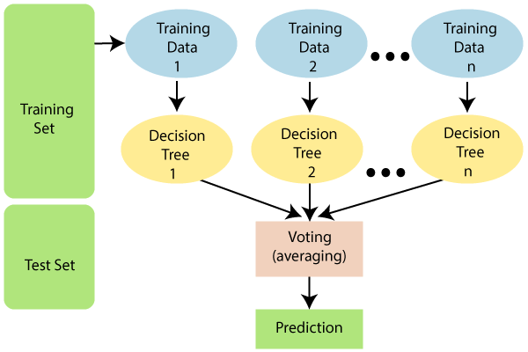
Random Forest works in two-phase first is to create the random forest by combining N decision tree, and second is to make predictions for each tree created in the first phase.
The Working process can be explained in the below steps and diagram:
Step-1: Select random K data points from the training set.
Step-2: Build the decision trees associated with the selected data points (Subsets).
Step-3: Choose the number N for decision trees that you want to build.
Step-4: Repeat Step 1 & 2.
Step-5: For new data points, find the predictions of each decision tree, and assign the new data points to the category that wins the majority votes.

Slide 11
Dataset Used:
For this we have used Cleveland Dataset from UCI library. The dataset contains as many as 76 parameters describing the complete health status of heart. These parameters are obtained by expensive clinical tests like ECG, CT scan etc. Out of these, the traditional heart disease prediction system uses 13 major parameters .Since these parameters require expensive lab tests to find ECG , chest pain type, ST depression etc. To avoid these and to make system less complex we selected above mentioned parameters which can be easily measured using different sensors available in the market.

Slide 12
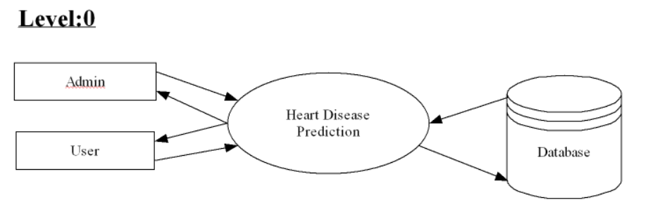
DATA FLOW DIAGRAM
LEVEL : 0

Slide 13
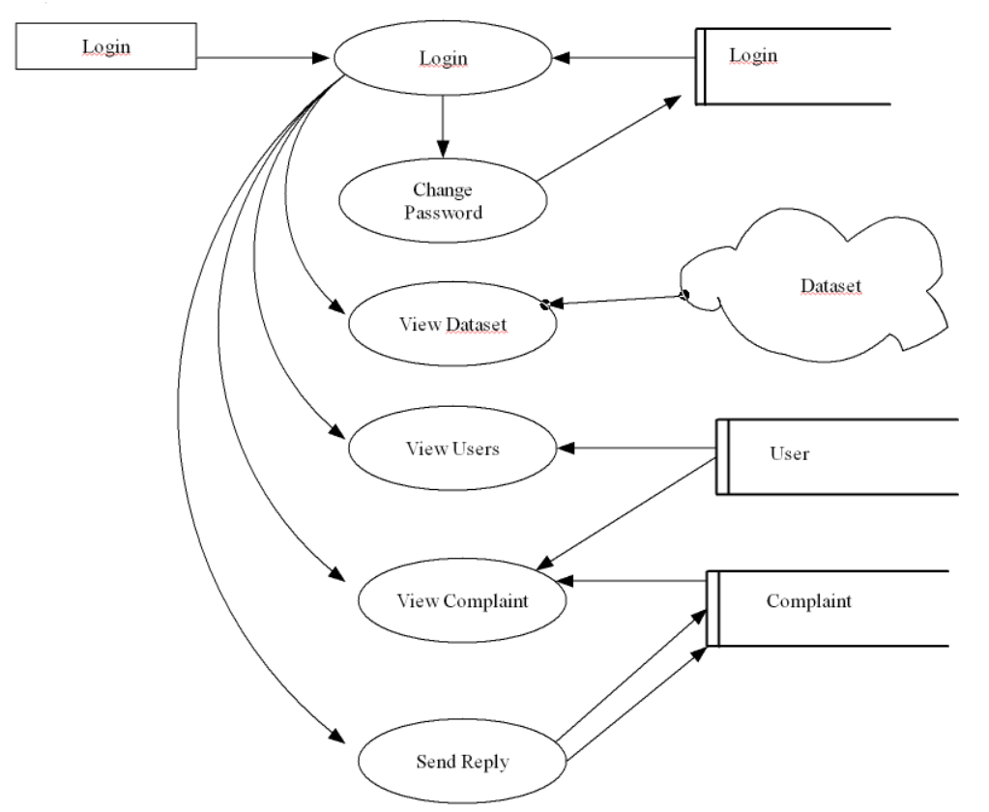
LEVEL : 1

Slide 14
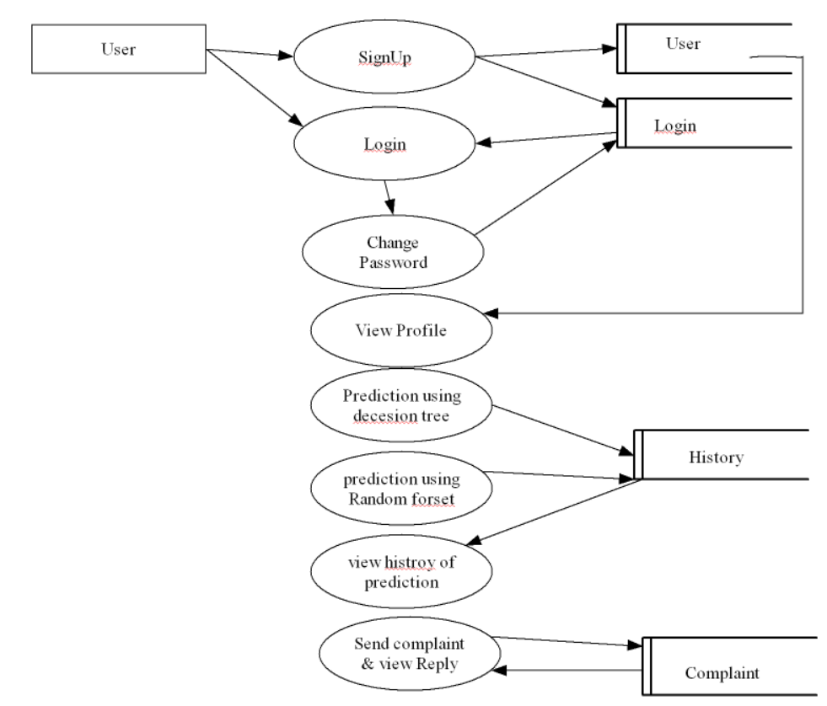
LEVEL : 2

Slide 15
TABLE DESIGN
1.LOGIN
Field Name | Datatype | Constraints
1.Lid | int | Primary key
2.Username | Varchar(50) | Not null
3.Password | Varchar(50) | Not null
4.type | Varchar(50) | Not null

Slide 16
2.COMPLAINT:
Field Name | Datatype | Constraints
1.cid | int | Primary key
2.Complaint | Varchar(100) | Not null
3.ulid | Int | Not null
4.date | date | Not null
5.reply | Varchar(100) | Not null
6.status | Varchar(100) | Not null

Slide 17
3.USER:
Field Name | Datatype | Constraints
1.Userid | int | Primary key
2.Lid | int | Foreign key
3.name | Varchar(50) | Not null
4.DOB | date | Not null
5.Email | Varchar(50) | Not null
6.Phone | int | Not null
7.house | Varchar(50) | Not null
8.pin | int | Not null
9.post | Varchar(50) | Not null
10.district | Varchar(50) | Not null

Slide 18
4.HISTORY:
Fieldname | datatype | constraints
Name | Varchar(50) | Not null
Id | int | Primary key
Age | int | Not null
sex | int | Not null
Cp | int | Not null
trestbps | int | Not null
chol | int | Not null
fbs | int | Not null
restecg | int | Not null
thal | int | Not null
Prediction | int | Not null

Slide 19
thalach | int | Not null
exang | int | Not null
oldpeak | int | Not null
slope | int | Not null
ca | int | Not null

Slide 20
DEVELOPING ENVIRONMENT
Hardware Requirements:
Input Device : Mouse, Keyboard
Output Device : Monitor
Memory : 4 Gb Ram(Minimum)
Processor : Intel core i3 or above
Software Requirements:
Operating System : Windows 8 /10 for Better Performance
Front End : Python (Flask)
Back End : Mysql
Software Used : Pycharm
Web Browser :Internet Explorer/Google Chrome/Firefox(for web application)

Slide 21
Future Enhancements
Currently I have developed a web application for predicting heart disease. In the future I have planned to add more readings or more features related to heart diagnosis.
Also we can integrate this application with devices or machines used to test heart diseases and get immediate results .

Slide 22
USER STORY
User Story ID | As a type of User | I want to | So that I can
1 | Admin | Login | I can get access to the system
2 | User | Signup | Can save my details required for login
3 | User | Login | I can get access to the system
4 | Admin | Change password | I can change my login credentials
5 | Admin | View Dataset | Can View the dataset used for prediction
6 | Admin | View users | Can view the users registered within the system.
7 | User | Change password | I can change my login credentials
8 | User | View profile | I can view my profile
9 | User | Send Complaint | I can send my complaints

Slide 23
User Story ID | As a type of User | I want to | So that I can
10 | Admin | View Complaint | Can view the complaints
11 | admin | Send reply | I can send appropriate reply for complaint
12 | User | View reply | I can view the reply
13 | Admin | Prediction using decision tree | I can predict the chances of heart desease to happen using decision tree
14 | Admin | Prediction using random forest | I can predict the chances of heart desease to happen using random forest
15 | User | View history of prediction | I can view the prediction result
16 | User | Testing the data | Input new Dataset
17 | User | Output generation | Output from TTS

Slide 24
PRODUCT BACKLOG
User story ID | Priority <High/Medium/Low> | Size (Hours) | Sprint <#> | Status <Planned/In progress/Completed> | Release Date | Release Goal
1 | Medium | 6 | 1 | Completed | 10/01/2022 | Form designing and table designing
2 | High | 8 |  | Completed | 10/01/2022 | Coding session
3 | Medium | 5 | 2 | planned | 23/01/2022 | Form designing and coding session
4 | High | 5 |  | planned | 06/02/2022 | Coding and Dataset loading
5 | Medium | 8 | 3 | planned | 13/02/2022 | Training the dataset
6 | High | 8 |  | planned | 27/02/2022 | Output Prediction
7 | Medium | 5 | 4 | planned | 10/03/2022 | Technical code settings
8 | High | 5 |  | planned | 15/03/2022 | Output generation

Slide 25
Project plan
User story id | Task name | Start date | End date | Days | Status
 |  | Sprint1
1 | UI Designing | 30/11/2021 | 02/12/2021 | 4 | Completed
2 | Database connectivity | 10/12/2021 | 12/12.2021 | 3 | Completed
3 | Coding | 22/11/2021 | 31/12/2021 | 10 | Completed
 |  | Sprint 2
4 | UI Designing | 15/01/2022 | 17/01/2022 | 3 | planned
5 | Database connectivity | 21/01/2022 | 22/01/2022 | 2 | planned
6 | Coding | 29/01/2022 | 31/01/2022 | 3 | planned

Slide 26
User story id | Task name | Start date | End date | Days | Status
 |  | Sprint3
7 | UI Designing | 05/02/2022 | 07/02/2022 | 3 | planned
8 | Database connectivity | 09/02/2022 | 10/02/2022 | 2 | planned
9 | Coding | 12/02/2022 | 21/02/2022 | 10 | planned
 |  | Sprint 4
10 | Testing | 22/02/2022 | 23/02/2022 | 2 | planned
11 | Validation | 24/02/2022 | 25/02/2022 | 2 | planned

Slide 27
Sprint Backlog Plan
Backlog Items | Status and Completion date | Original estimate in hours | Day1 1/3 | Day2 2/3 | Day3 3/3 | Day4 4/3 | Day5 5/3 | Day6 6/3 | Day7 7/3 | Day8 8/3 | Day9 9/3 | Day10 10/3 | Day11 11/3 | Day12 12/3 | Day13 13/3 | Day14 14/3 | Day15 15/3
User story #1,2,3,4 |  | Hrs | Hrs | Hrs | Hrs | Hrs | Hrs | Hrs | Hrs | Hrs | Hrs | Hrs | Hrs | Hrs | Hrs | Hrs | Hrs
UI designing | 10/12/2021 | 3 | 0 | 0 | 0 | 0 | 2 | 1 | 0 | 0 | 0 | 0 | 0 | 0 | 0 | 0 | 0
Database connectivity | 12/12/2021 | 2 | 0 | 0 | 1 | 0 | 1 | 0 | 0 | 0 | 0 | 0 | 0 | 0 | 0 | 0 | 0
Coding | 17/12/2021 | 4 | 0 | 1 | 0 | 2 | 1 | 0 | 0 | 0 | 0 | 0 | 0 | 0 | 0 | 0 | 0
Testing | 21/12/2021 | 1 | 0 | 1 | 0 | 0 | 0 | 0 | 0 | 0 | 0 | 0 | 0 | 0 | 0 | 0 | 0
User story #5,6,7,9,10
UI designing | 24/12/2021 | 0 | 2 | 0 | 0 | 0 | 0 | 0 | 0 | 0 | 1 | 1 | 0 | 0 | 0 | 0 | 0
Database connectivity | 26/12/2021 | 0 | 2 | 0 | 0 | 0 | 1 | 1 | 0 | 0 | 0 | 0 | 0 | 0 | 0 | 0 | 0
Coding | 26/12/2021 | 0 | 4 | 1 | 0 | 2 | 0 | 1 | 0 | 0 | 0 | 0 | 0 | 0 | 0 | 0 | 0
Testing | 31/12/2021 | 0 | 1 | 0 | 0 | 0 | 0 | 0 | 0 | 0 | 0 | 0 | 0 | 0 | 0 | 0 | 0

Slide 28
User story #8,12 | Status and Completion date | Original estimate in hours | Day1 2/3 | Day2 3/3 | Day3 4/3 | Day4 5/3 | Day5 6/3 | Day6 7/3 | Day7 8/3 | Day8 9/3 | Day9 10/3 | Day10 11/3 | Day11 12/3 | Day12 13/3 | Day13 14/3 | Day14 15/3
UI designing | 15/1/2022 | 3 | 1 | 0 | 1 | 0 | 1 | 0 | 0 | 0 | 0 | 0 | 0 | 0 | 0 | 0
Database connectivity | 16/1/2022 | 2 | 1 | 1 | 0 | 0 | 0 | 0 | 0 | 0 | 0 | 0 | 0 | 0 | 0 | 0
Coding | 20/1/2022 | 5 | 2 | 1 | 0 | 0 | 2 | 0 | 0 | 0 | 0 | 0 | 0 | 0 | 0 | 0
Testing | 29/1/2022 | 1 | 1 | 0 | 0 | 0 | 0 | 0 | 0 | 0 | 0 | 0 | 0 | 0 | 0 | 0
User story #13,14,15,16,17
UI designing | 6/2/2022 | 5 | 1 | 2 | 0 | 0 | 1 | 1 | 0 | 0 | 0 | 0 | 0 | 0 | 0 | 0
Database connectivity | 8/2/2022 | 5 | 2 | 0 | 0 | 1 | 1 | 0 | 0 | 0 | 0 | 0 | 0 | 0 | 0 | 0
Coding | 10/2/2022 | 8 | 2 | 1 | 1 | 0 | 0 | 2 | 1 | 1 | 0 | 0 | 0 | 0 | 0 | 0
Testing | 15/2/2022 | 2 | 1 | 1 | 0 | 0 | 0 | 0 | 0 | 0 | 0 | 0 | 0 | 0 | 0 | 0

Slide 29
Sprint 1 Actual
Backlog Items | Status and Completion date | Original estimate in hours | Day1 2/3 | Day2 3/3 | Day1 4/3 | Day1 5/3 | Day1 6/3 | Day1 7/3 | Day1 8/3 | Day1 9/3 | Day1 10/3 | Day1 11/3 | Day1 12/3 | Day1 13/3 | Day1 14/3 | Day1 15/3 | Completed <Y/N>
User story #1,2,3,4 |  | Hrs | Hrs | Hrs | Hrs | Hrs | Hrs | Hrs | Hrs | Hrs | Hrs | Hrs | Hrs | Hrs | Hrs | Hrs | YES
UI designing | 10/12/2021 | 3 | 0 | 0 | 0 | 2 | 1 | 0 | 0 | 0 | 0 | 0 | 0 | 0 | 0 | 0 | YES
Database connectivity | 12/12/2021 | 2 | 0 | 1 | 0 | 1 | 0 | 0 | 0 | 0 | 0 | 0 | 0 | 0 | 0 | 0 | YES
Coding | 17/12/2021 | 4 | 1 | 0 | 2 | 1 | 0 | 0 | 0 | 0 | 0 | 0 | 0 | 0 | 0 | 0 | YES
Testing | 21/12/2021 | 1 | 1 | 0 | 0 | 0 | 0 | 0 | 0 | 0 | 0 | 0 | 0 | 0 | 0 | 0 | YES
User story #5,6,7,9,10,11 |  |  |  |  |  |  |  |  |  |  |  |  |  |  |  |  | YES
UI designing | 24/12/2021 | o | 0 | 0 | 0 | 0 | 0 | 0 | 0 | 0 | 0 | 0 | 0 | 0 | 0 | 0 | YES
Database connectivity | 26/12/2021 | 0 | 0 | 0 | 0 | 0 | 0 | 0 | 0 | 0 | 0 | 0 | 0 | 0 | 0 | 0 | YES
Coding | 26/12/2021 | 0 | 0 | 0 | 0 | 0 | 0 | 0 | 0 | 0 | 0 | 0 | 0 | 0 | 0 | 0 | YES
Testing | 31/12/2021 | 0 | 0 | 0 | 0 | 0 | 0 | 0 | 0 | 0 | 0 | 0 | 0 | 0 | 0 | 0 | YES
Total |  | 10 | 0 | 0 | 0 | 0 | 0 | 0 | 0 | 0 | 0 | 0 | 0 | 0 | 0 | 0

